Slide 1
LO: Analyze the impact this had on Germany in 1923
Occupation of the Ruhr

Slide 2
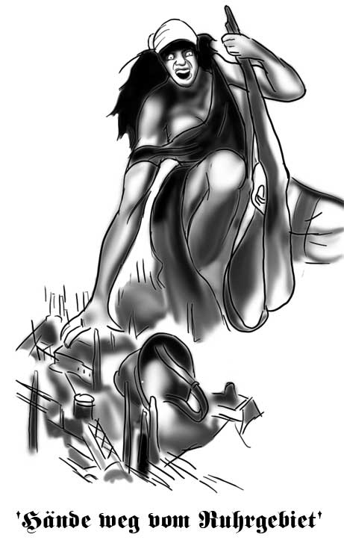
LO: Analyze the impact this had on Germany in 1923
Occupation of the Ruhr

