Slide 1
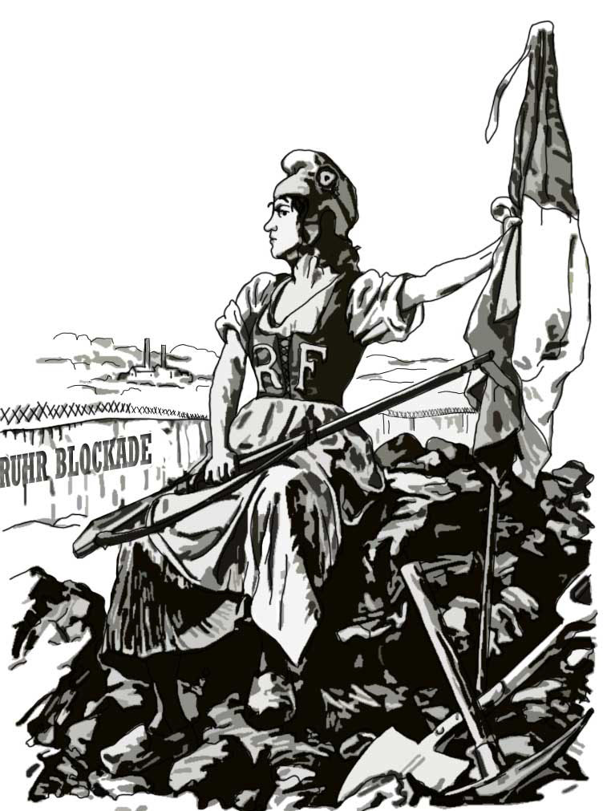
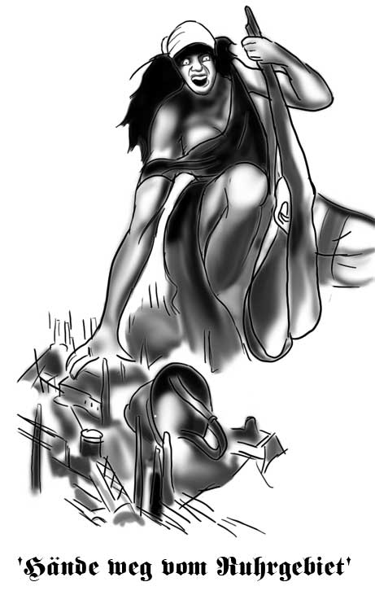
Review each poster by clicking on it. Start with the poster on the right
J’Y SUIS – J’Y RESTE

Slide 2
LO: Analyze the impact this had on Germany in 1923
Occupation of the Ruhr
J’Y SUIS – J’Y RESTE
This is representation of a British cartoon from Punch, 1923.
This is representation of a German Poster, 1923.

Slide 3
LO: Analyze the impact this had on Germany in 1923
Occupation of the Ruhr
What can you see?

Slide 4
Now, click on the sections of the poster that you want to find out more about.

Slide 5
LO: Analyze the impact this had on Germany in 1923
Occupation of the Ruhr
Females are often used to represent countries. The country represented here is France.
How is she being portrayed?
What is she holding?
What is the significance of these objects?

Slide 6
LO: Analyze the impact this had on Germany in 1923
Occupation of the Ruhr
What type of buildings can you see here?
What is happening to the buildings?
How important do you think these buildings were to Germany after the war?
What may the military helmet represent?

Slide 7
LO: Analyze the impact this had on Germany in 1923
Occupation of the Ruhr
The caption says -
‘Hands off the Ruhr!’
What do you think the Ruhr is and who do you believe it belongs to?

Slide 8
LO: Analyze the impact this had on Germany in 1923
Occupation of the Ruhr
J’Y SUIS – J’Y RESTE
What can you see?

Slide 9
J’Y SUIS – J’Y RESTE
What you can see?
Now, click on the sections of the poster that you want to find out more about.

Slide 10
LO: Analyze the impact this had on Germany in 1923
Occupation of the Ruhr
J’Y SUIS – J’Y RESTE
Here I Am – Here I Stay
How determined is the lady to stay where she is?
How do you know?

Slide 11
LO: Analyze the impact this had on Germany in 1923
Occupation of the Ruhr
Who do you think that this lady represents?
What helped you to make up your mind?

Slide 12
LO: Analyze the impact this had on Germany in 1923
Occupation of the Ruhr
What is meant by the term ‘Blockade’?
Who is using a blockade and why may they be doing this?

Slide 13
LO: Analyze the impact this had on Germany in 1923
Occupation of the Ruhr
What is the lady sat on?
Does this give you a clue as to what this area was famous for?

Slide 14
Comparative study
J’Y SUIS – J’Y RESTE
The cartoon on the left is British and the poster on the right is German.
Why do you think that they give different interpretations of the invasion and occupation of the Ruhr by the French?

Slide 15
Here I Am – Here I Stay
Look again at the British cartoon.
How successful and justified does the occupation look according to this source?
Clue: Look at the expression, the pose, the title, the defences….

Slide 16
J’Y SUIS – J’Y RESTE
Hands Off The Ruhr !
Look again at the German Poster.
How successful and justified does the occupation look according to this source?
Clue: Look at the expression, the character, the title….

Slide 17
J’Y SUIS – J’Y RESTE
Which interpretation of this event do you think is the most accurate?
Explain your answer carefully.

