Slide 1
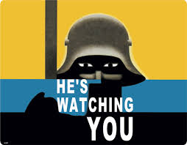
Why were the Nazis able to control opposition so effectively?
icHistory.com

Slide 2
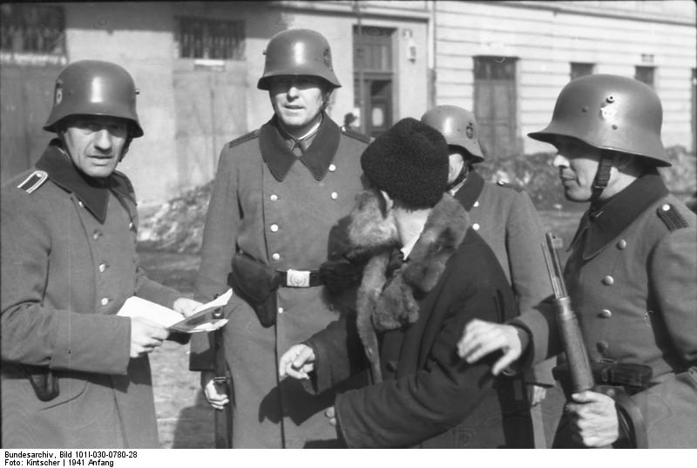
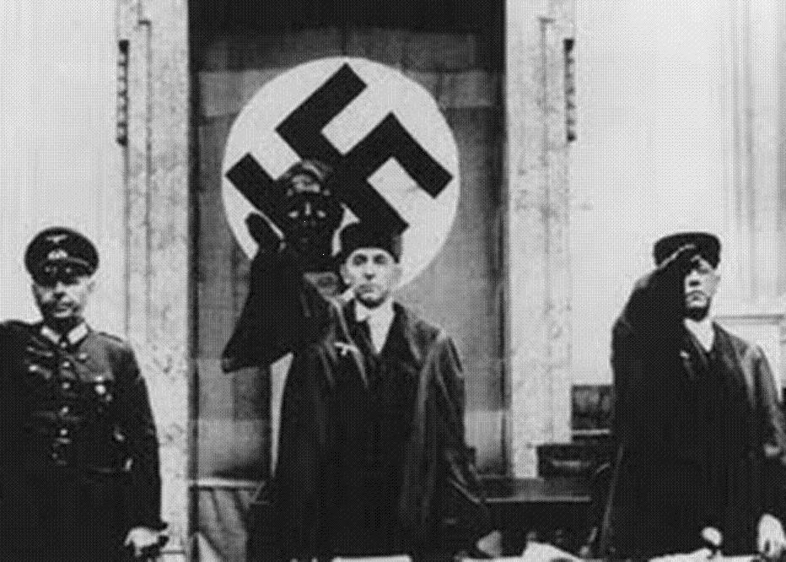
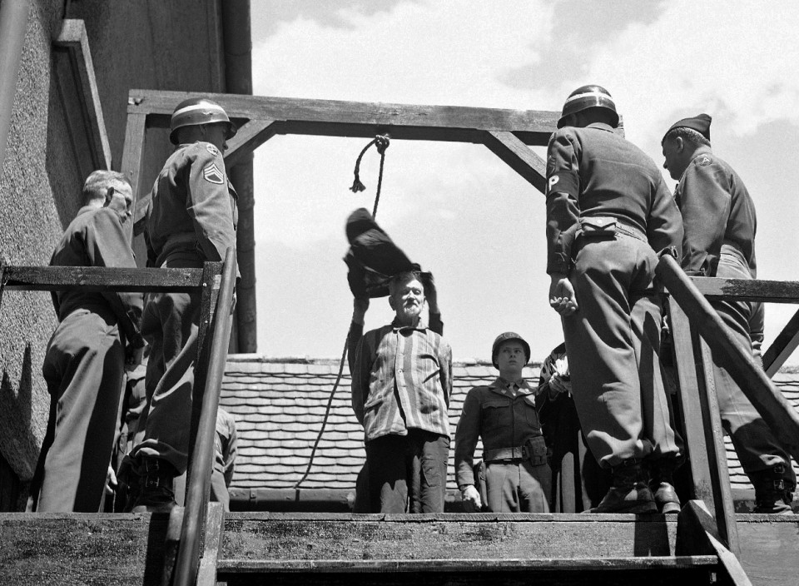
Why were the Nazis able to control opposition so effectively? Intro : The short answer is through FEAR via the creation of a POLICE STATE. To develop the answer think … ATP Arrest Trial Punishment

Slide 3
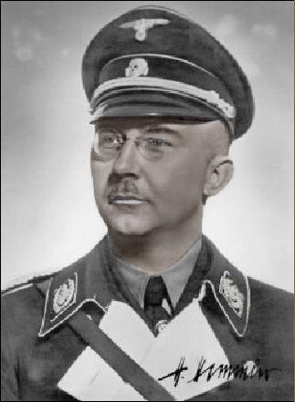
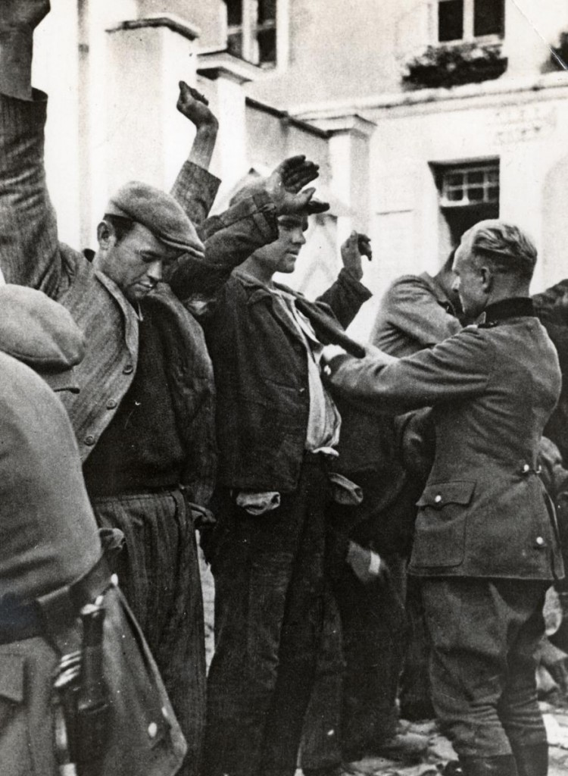
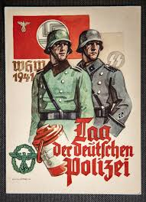
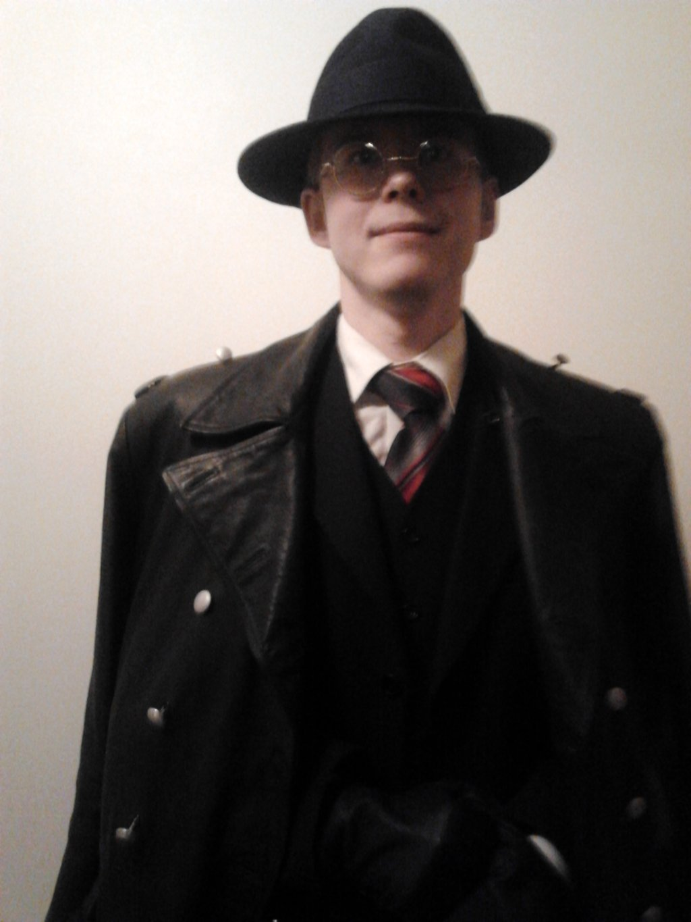
Arrest The SS The SS was created in 1925 and was led by Heinrich Himmler. The SS were the fanatic, loyal Nazi soldiers. They would be used to beat up and arrest any opposition. The SS was split into 3 areas…
1: The SS was Hitler’s private army 2: Waffen SS fought with the regular army
3: Death’s Head Units ran concentration camps
ORPO (Ordnungspolizei)
The ORPO was the standard police force and was also controlled by Himmler.

Slide 4
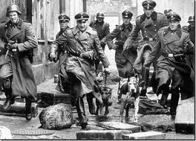
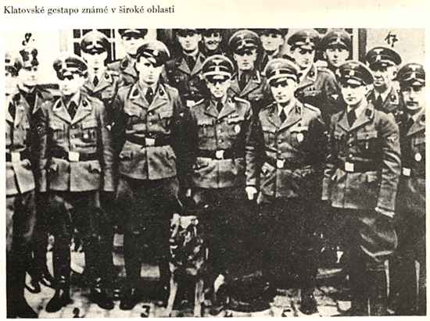
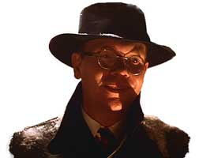
Arrest 2 Gestapo
The Gestapo were the Nazis Secret Police and were also led by Himmler. They tapped telephones and spied on people. They had informers who would tell on anyone who spoke against the Nazis. People were scared that their friends or neighbours might be Gestapo informers and were scared to speak against Hitler. This fear and paranoia was a very effective way to ensure that grumbling was kept to behind closed doors!

Slide 5
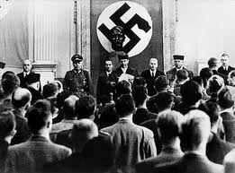
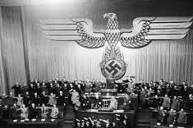
Trial Once a person was arrested by the SS or Gestapo they were taken to court. The police, courts and judges had been taken over by the Nazis. Judges had to swear an oath of loyalty to Hitler. Those who refused were dismissed or worse. It was therefore very easy for the Nazis to get people put imprison even without any real evidence against them. As a result of the Enabling Law Hitler was able to make any laws he wanted. He used this as a way to find excuses to imprison or kill off opponents. He even created a law that forbade the telling of anti-Nazi jokes.
Number of crimes punishable by death.
1933 = 3
1943 = 46

Slide 6
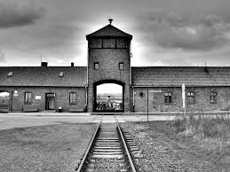
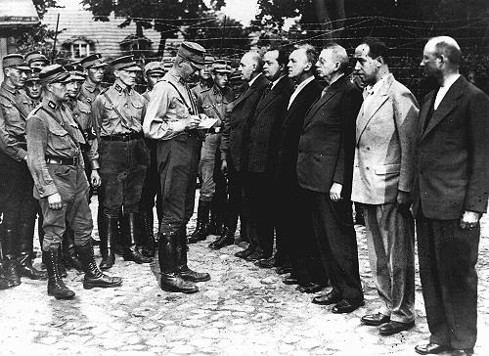
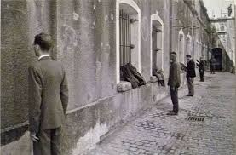
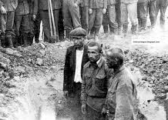
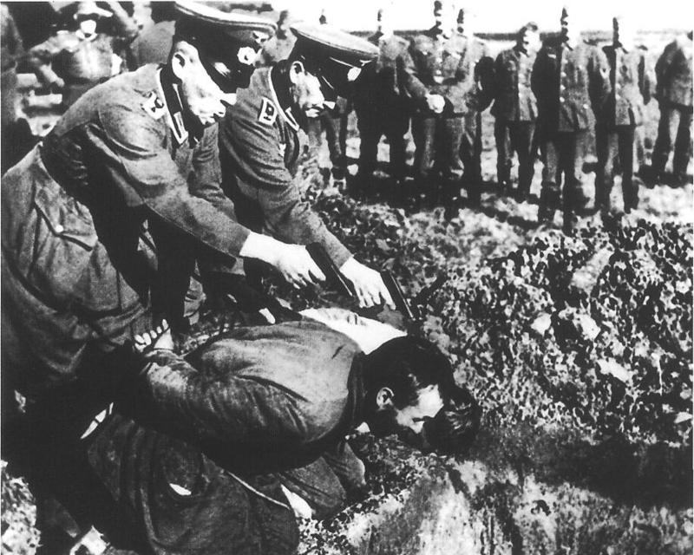
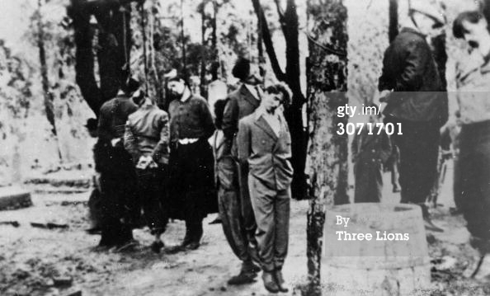
Punishment Concentration Camps
Special camps were built to house the Nazi opponents or anyone who was not useful to the new German Reich. Most German people did not know for sure what happened in the camps but saw that most people taken there did not return. The fear of the unknown was a very powerful deterrent! Political opponents would be tortured for information and forced to do hard labour (work). Often they died of exhaustion, starvation or were executed. Later these became death camps used to kill people in gas chambers. One of the most infamous camps was Auschwitz in Poland.

